Slide 1
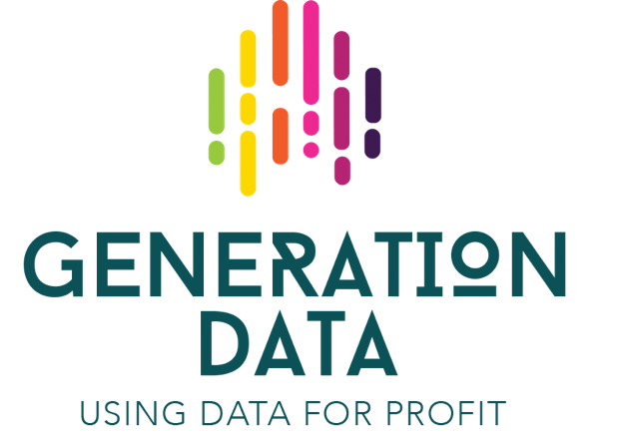
The Truth about Data
Dr. Eoghan Furey
Letterkenny Institute of Technology, Ireland

Slide 2
Data Analytics – Getting is right!
Data is a powerful tool when used properly, and it lends itself to informed decision making – but “informed” is the key word. Being informed doesn't just mean using an evidence base; it means understanding how that evidence was gathered and where it might fall short.

Slide 3
Sample v Population

Slide 4
Bias (Confirmation?)

Slide 5
Correlation and Causation

Slide 6
Dirty Data – Garbage in = Garbage Out

Slide 7
Beware of statistics and fancy graphs!

Slide 9
What question are you asking?

Slide 10
Business Analytics
You need a business case, you need to find a niche in the market, define your product, find out if it’d be successful and also possible to create and then, you may use some technology to create it.
https://www.youtube.com/watch?v=3zc4bGkU05o

Slide 11
Hiring a Data Analyst?

Slide 12
“Just a flu” or global panic? This is why some people are much more afraid of coronavirus than others
https://www.prospectmagazine.co.uk/science-and-technology/coronavirus-death-rate-risk-uk-usa-what-is

Slide 13
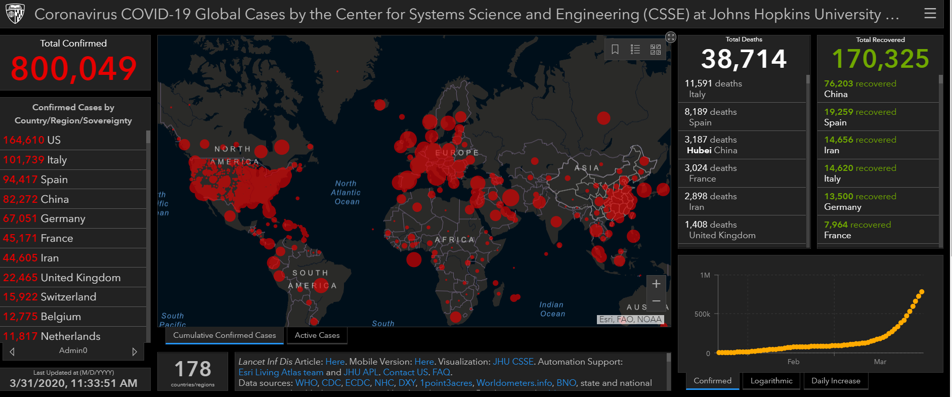
Coronavirus Analytics
https://coronavirus.jhu.edu/map.html

Slide 14
Go raibh maith agat.

